Slide 1
Cascading Style Sheet (CSS )
Language that describes the style of an HTML document and how HTML elements should be displayed
Notes:
http://www.w3schools.com/
https://www.codecademy.com/articles/html-inline-stylescss/css_syntax.asp

Slide 2
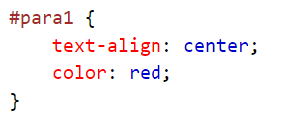
ID SELECTORS
uniquely style sections of a page, based on the id attribute.
select a single, unique element.
use a hash character, followed by the id of the element

Slide 3
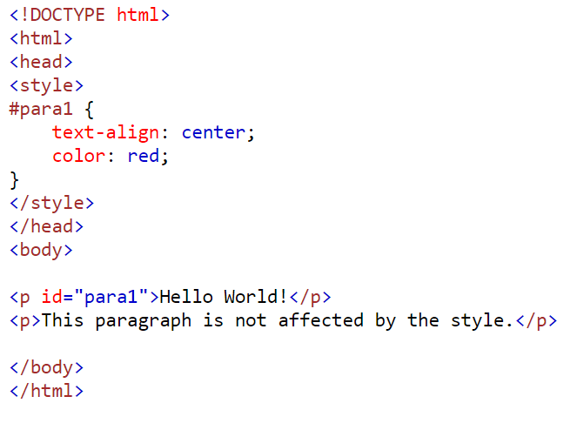

Slide 4
APPLYING ID selector : INTERNAL CSS
using ID selector, modify the format for word Robot
Apply an ID selector with the id value = modify inside <yourname>.
Apply font face = “Helvetica”
Apply background color = “yellow”
Apply for word Robot inside content only.
Ignore all word Robot inside heading

Slide 5
APPLYING ID selector : INTERNAL CSS
Apply in style tag
#modify {font-family: Helvetica;
background-color:yellow }
Apply in body tag
<wahida id = modify> Robot</wahida>

Slide 6
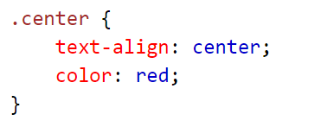
CLASS SELECTORS
Custom selector, similar to id selector but can be applied multiple times
Use a period character, followed by the name of the class

Slide 7
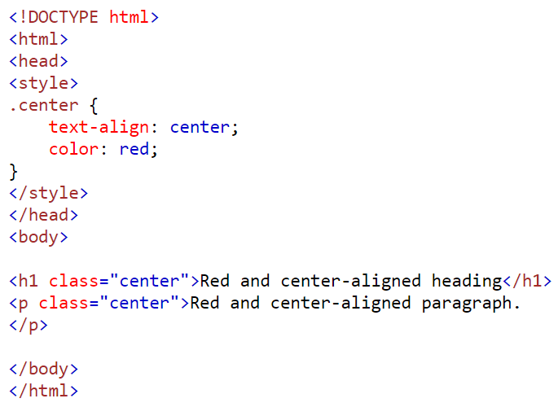

Slide 8
APPLYING CLASS selector : INTERNAL CSS
For heading tag, apply border-style: dotted and font case : uppercase. Class selector should be change.
Apply in style tag
.change {border-style:dotted ; text-transform:uppercase}
Apply in body tag
<h1 class = change > content </h1>
<h2 class = change > content </h2>

Slide 9

APPLYING CSS : EXTERNAL STYLE SHEET
An external style sheet is used to define the style for many HTML pages.
To use an external style sheet, add a link to it in the <head> section of the HTML page
An external style file with extension .css (should not contain html tags)
Each web page has to include a link to the css file
<head>
<link rel="stylesheet" type="text/css" href=“style1.css"> </head>

Slide 10
APPLYING : EXTERNAL CSS
Open a new document and paste code given
<html >
<head>
<style>
* { box-sizing: border-box;}
body { margin: 0;}
/* Style the header */
.header {
background-color: #f1f1f1;
padding: 20px;
text-align: center;
}
/* Style the top navigation bar */
.topnav {
overflow: hidden;
background-color: #333;
}
/* Style the topnav links */
.topnav a {
float: left;
display: block;
color: #f2f2f2;
text-align: center;
padding: 14px 16px;
text-decoration: none;
}
/* Change color on hover */
.topnav a:hover {
background-color: #ddd;
color: black;
}
</style>
</head>
Save your document as style.css

Slide 11
APPLYING : EXTERNAL CSS
Type code below inside <head> robot.html
<link rel="stylesheet" type="text/css" href="style.css">
Type code below inside <body> robot.html
<div class="header">
<h1> Header </h1>
</div>

Slide 12
APPLYING : EXTERNAL CSS
Insert banner for entire website ; refer CSS file
.header {
background-color: white;
padding: 30px;
}
background-image:url(banner.jpg);
background-repeat: no-repeat;
background-position:right

Slide 13

APPLYING : INLINE CSS
Modify your code so that your output similar with image below. Apply <h1> <p> and <br>
Format for <p>
Typeface : century gothic
Alignment : center
Font size : 18pt

Slide 14
APPLYING : INLINE CSS
<h1> CREATING A WEBSITE USING TEXT EDITOR </h1>
<p style = "font-family: century gothic;
text-align:center;font-size:18pt">
SUBJECT CODE : PCT0101 <br>
SUBJECT NAME : INTRO TO COMPUTING TECH
</p>

Slide 15
APPLYING : EXTERNAL CSS
Paste code given inside <body> robot.html
<div class="topnav">
<a href="#">Link</a>
<a href="#">Link</a>
<a href="#">Link</a>
</div>

Slide 16

APPLYING : EXTERNAL CSS
Modify text inside <a> and add additional code

Slide 17
APPLYING : EXTERNAL CSS
Modify text inside <a> and add additional code
<div class="topnav">
<a href="#">HOMEPAGE</a>
<a href="#">GRAPHICS</a>
<a href="#">COURSEWORK</a>
<a href="#">ROBOT</a>
<a href="#">CSS STYLING IMAGES</a>
<a href="#">EMAIL</a>
</div>

Slide 18
APPLYING : EXTERNAL CSS
Activate hyperlink <a> inside robot page
RELATIVE LINK
Homepage , Graphics, Coursework, Robot
ABSOLUTE LINK
CSS Styling Images
EMAIL LINK
Email

Slide 19
APPLYING : EXTERNAL CSS
Activate hyperlink <a> inside robot page
<div class="topnav">
<a href=“index.html"> HOMEPAGE</a>
<a href=“graphics.html"> GRAPHICS</a>
<a href=“coursework.html"> COURSEWORK</a>
<a href=“robot.html"> ROBOT</a>
<a href="https://www.w3schools.com/css/css3_images.asp">
CSS STYLING IMAGES</a>
<a href=“mailto:emailAddress">EMAIL</a>
</div>

Slide 20
APPLYING : EXTERNAL CSS
Insert image <img> inside robot page
Apply code below inside CSS page
img {
border: 2px solid #ddd;
border-radius: 4px;
padding: 5px;
width: 150px;
}

Slide 21
APPLYING : INTERNAL CSS
Change the opacity
Apply code below inside robot page
img:hover
{
opacity: 0.5;
filter: alpha(opacity=50);
}

Slide 22
APPLYING : INTERNAL CSS
Center images
Apply code below inside robot page
img {
display: block;
margin-left: auto;
margin-right: auto;
}

Slide 23



Slide 24
LAB EXERCISE
You need to create ONE WEBSITE with FIVE WEBPAGE.
You need to create ONE GALLERY page with 10 images and one video. Materials should be arrange in suitable layout and CSS STYLING IMAGES is a must.
All webpage should have
HEADER area with DIFFERENT HEADING and content.
FOOTER area with YOUR NAME and ID as the content.
NAVIGATION BAR with correct hyperlink
Apply name anchor link in any of the webpage
Zip your folder and upload to Google Classroom. Zip folder name should be yourName

